Slide 1
Transaction Processing

Slide 2
What is Transaction
Transaction Model
Isolation
Classification
Savepoint and Release point
Locking
Locking Levels
Views and its types
Horizontal
Vertical
Group
CHECK OPTION
Agenda

Slide 3
Transaction is a process of executing multiple DML statements sequentially to achieve a final task.
A transaction which is performing DML operations including Insertion, deletion, update of records ensures data integrity.
In an online application, the transactions happening on the database concurrently ensures the data is accurate and reliable without any loss.
Usually , in big organizations like banks perform millions of transactions per minute in database environment. All these transactions are processed through DML statements including INSERT, DELETE, UPDATE and SELECT statements.
All of these transactions ensure the database integrity and accuracy of data for users.
What is Transaction?

Slide 4
A transaction with DML statements follows the ACID properties.
Atomicity: It ensures the transaction is fulfilled; otherwise fail the transaction.
E.g: Ordering a Pizza is fulfilled with series of transactions like -
Choose an item - check the inventory
Order the dish - insert order details
Complete the order - includes payment transaction.
If the customer recalls the order at any stage, all the DML operations are rollbacked including changes to inventory, orders and payments.
However, if the transaction is completed, you will enjoy your Pizza.
Database commands : COMMIT , ROLLBACK will helps to achieve the atomicity.
What is Transaction?

Slide 5
Consistency :
Any failure of transactions due to database crash or network failures, the original state of data is retained.
During crash recovery, SQL engine replay the transactions recorded in doublewrite buffer.
Hence the data is consistent in the database without loss of transaction status.
It means it will have a record of the user SQL statements on the database, which are used for recovery process .

Slide 6
Isolation: Multiple DML statements concurrently hit the database and isolating one transaction from other transaction is the responsibility of database.
So one individual transaction is isolated from other transactions. It is achieved only by forming the Queue of transactions.
E.g: Assume Withdrawal of amount from ATM & internet transfer are two different transactions occured at the same second. Both transactions are transferring money from the account.
The two individual transactions are isolated , it means the database keeps the transactions in Queue to perform one transaction after the other to ensure the balance is sufficient to transfer the money.

Slide 7
SQL Transaction Model

Slide 8
A transaction is a series of DML statements enclosed within a block.
This transaction block can be anonymous or else stored the group of DML statements in a procedure block.
E.g: A transaction is identified with series of DML operations.
SELECT Operation -1 : Check bank balance
INSERT Operation -2 : Withdraw money from ATM - new entry into transaction table.
UPDATE Operation -3 : Update the balance by deducting with drawn money.
INSERT Operation - 4 : Calculate the service charge on withdrawn amount and insert a new entry in Transaction table.
UPDATE Operation - 5: Update the balance by deducting with service charge amount.
Technically , we will see how this transaction happens.
Transaction

Slide 9
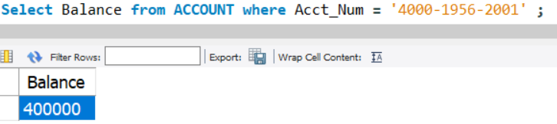
START TRANSACTION;
/* Check bank balance */
Select Balance from ACCOUNT where Acct_Num = '4000-1956-2001' ;
/* Bank charges 0.2% on withdrawn money */
Insert Transaction values ('4000-1956-2001' , -2300.00 * 0.02, 'ATM Withdrawal' , 'CA' , now());
/* Update the old balance with new balance. */
Update ACCOUNT set balance = balance - 2300 * 0.02 where Acct_Num = '4000-1956-2001' ;
COMMIT ;
Start of Transaction

Slide 10
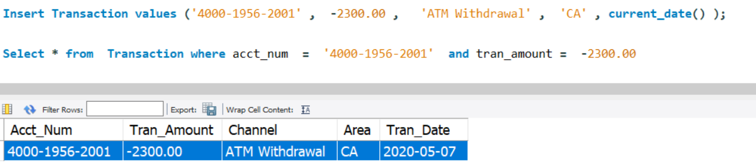
START TRANSACTION;
/* Check bank balance */
Select Balance from ACCOUNT where Acct_Num = '4000-1956-2001' ;
/* Withdraw money from ATM */
Insert Transaction values ('4000-1956-2001' , -2300.00, 'ATM Withdrawal' , 'CA' , now() ) ;
Transaction

Slide 11
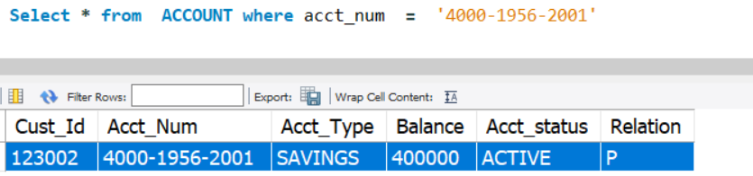
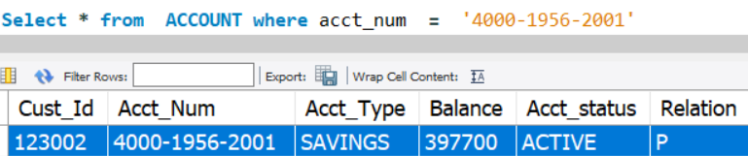
Before Update of ACCOUNT balance.
Update the old balance with new balance:
UPDATE Account
SET balance = balance - 2300
WHERE Acct_Num = '4000-1956-2001' ;
Transaction

Slide 12
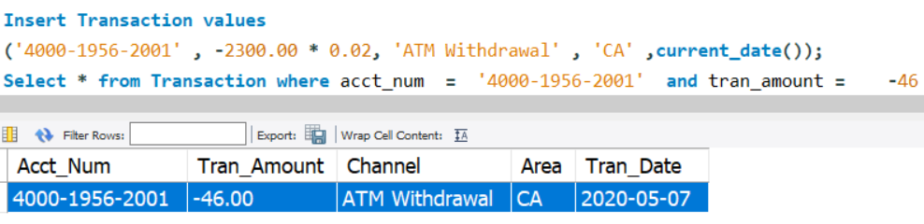
/* Bank charges 0.2% on withdrawn money */
Insert Transaction values
('4000-1956-2001', -2300.00 * 0.02,'ATM Withdrawal','CA' ,current_date());
Transaction

Slide 13
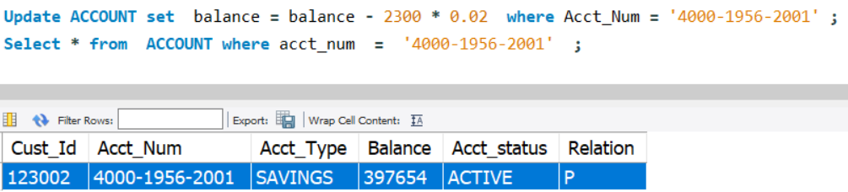
/* Update the old balance with new balance. */
Update ACCOUNT
Set balance = balance - 2300 * 0.02
WHERE Acct_Num = '4000-1956-2001' ;
/* End of transaction */
COMMIT;
End of Transaction

Slide 14
In the above Start and End of transaction,
the transaction is atomic and completes the transaction of ATM withdrawal of money with some charges
- COMMIT ensures that transaction is fulfilled
- ROLLBACK the transaction, if customer ignores to withdraw the money from ATM, all of the above transactions are reversed from database .
The database will retain your original balance in the account.
Transaction Summary

Slide 15
SET transaction controls performs the below tasks
- Encapsulate the DML statements
- Separates the execution of DML statements from DML statements of other transactions.
- Inter- lock the underlying affected records.
Note:
To ensure data integrity, each transaction should be consistent .
It means each DML statement should know the latest value of the underlying record though the record is affected by multiple transactions at same time.
Finally, the data Integrity is achieved only by below:
-Restrict other transactions performing the tasks on same records.
-Maintain the isolation of transactions with other transactions. So that other transactions wait in Queue to perform .
Set Transaction

Slide 16
Example:
At 9:00 AM , One transaction tries to update the balance of an Account - 123456
and expected to complete by 9:05 AM.
At 9:02 AM : Meanwhile, another transaction updates the balance of same Account -
123456
Here, the functionality of transactions is:
The second transaction occurred at 9:02 AM will not have access to the Account - 123456 until 9:05 AM.
Hence, it will keep on waiting until the first transaction is completed and execute after 9:05 AM.
This functionality is said to be in ISOLATION which is set by MySQL, and will study more.
Set Transaction - Example

Slide 17
MySQL - ISOLATION plays an important role in keep waiting of the transactions.
This is done internally and users need not aware of it.
However, these ISOLATION levels can be manually altered by user and can modify such constraints and still achieve data integrity and performance.
ISOLATION

Slide 18
Classification of ISOLATION levels:
ISOLATION levels are classified as
- REPEATABLE - READ
- READ COMMITTED
- SERIALIZABLE
Note:
Methods including READ , WRITE on transactions can also achieve Isolation.
Classification of Isolation levels

Slide 19
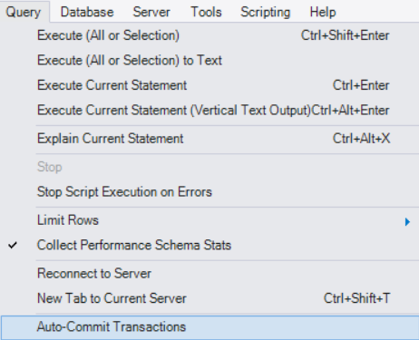
Pre-requisite:
Disable Auto- commit transaction
Practise Sessions

Slide 20
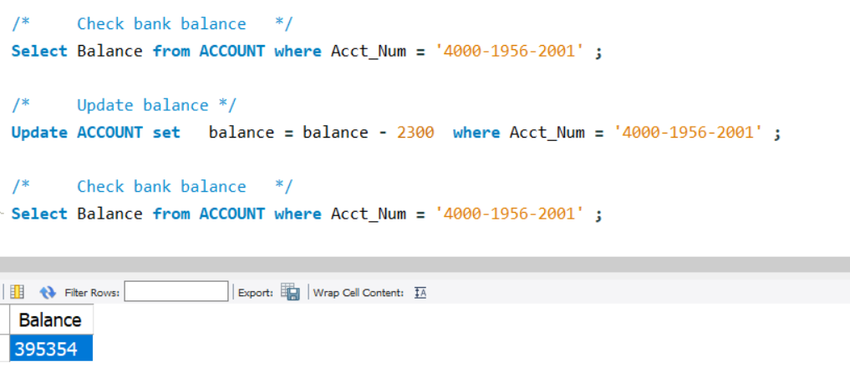
REPEATABLE READ: Lock the table in first Transaction affecting other Instances.
Perform below steps in “Instance - 1” and see result of each SQL statement.
( Ensure to disable Auto-commit )
/* MYSQL Workbench Instance - 1 */
SET TRANSACTION ISOLATION LEVEL REPEATABLE READ;
/* Check bank balance */
Select Balance from ACCOUNT where Acct_Num = '4000-1956-2001' ;
/* Update balance */
Update ACCOUNT set balance = balance - 2300 where Acct_Num = '4000-1956-2001' ;
/* Check bank balance */
Select Balance from ACCOUNT where Acct_Num = '4000-1956-2001' ;
Result of Instance - 1
ISOLATION - Repeatable Read

Slide 21
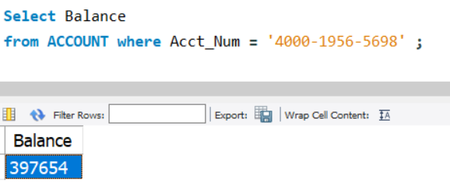
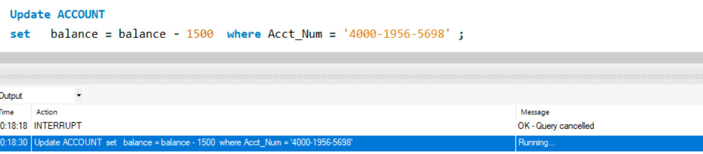
REPEATABLE READ: Experience table level lock using UPDATE statement
/* MYSQL workbench , Instance - 2 */
/* Check bank balance of different account */
Select Balance
from ACCOUNT
where Acct_Num = '4000-1956-5698' ;
Result of Instance - 2
/* Update balance */
Update ACCOUNT
set balance = balance - 1500
where Acct_Num = '4000-1956-5698' ;
In Instance - 2, the status of UPDATE keeps RUNNING.
No additional records can be inserted. Because of session -1 acquired lock at table level.
ISOLATION - Repeatable Read

Slide 22
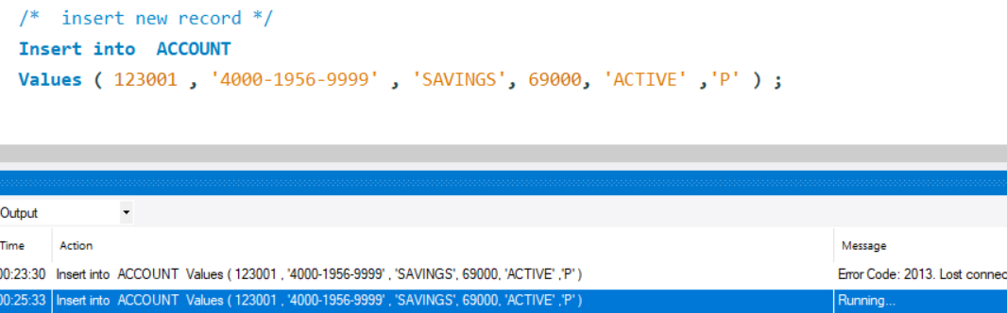
REPEATABLE READ: Experience table level lock using INSERT statement
Result of Instance - 2
/* MYSQL workbench , Instance - 2 */
/* Insert new record */
Insert into ACCOUNT
Values ( 123001 , '4000-1956-9999' , 'SAVINGS', 69000, 'ACTIVE' ,'P' ) ;
In Instance - 2, the status of INSERT keeps RUNNING.
Because of session -1 has acquired the lock on the ACCOUNT table.
ISOLATION - Repeatable Read

Slide 23
REPEATABLE READ: Experience table level lock with below practice, impacts other records.
/* MYSQL workbench , Instance - 2 */
/* Check bank balance of different account */
Select Balance
from ACCOUNT
where Acct_Num = '4000-1956-5698' ;
Result of Instance - 2
/* Update balance */
Update ACCOUNT
set balance = balance - 1500
where Acct_Num = '4000-1956-5698' ;
In Instance - 2, the status of UPDATE keeps RUNNING.
No additional records can be inserted. Because of session -1 acquired lock at table level.
ISOLATION - Repeatable Read

Slide 24
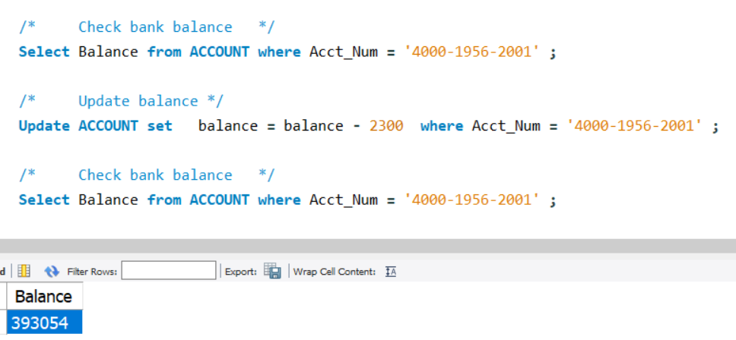
READ COMMITTED : Experience record level lock with below practice.
/* MYSQL workbench - Instance - 1 */
SET TRANSACTION ISOLATION LEVEL READ COMMITTED
/* Check bank balance */
Select Balance from ACCOUNT where Acct_Num = '4000-1956-2001' ;
/* Update balance */
Update ACCOUNT set
balance = balance - 2300 where Acct_Num = '4000-1956-2001' ;
/* Check bank balance */
Select Balance from ACCOUNT where Acct_Num = '4000-1956-2001' ;
Result of Instance -1
ISOLATION - Read Committed

Slide 25
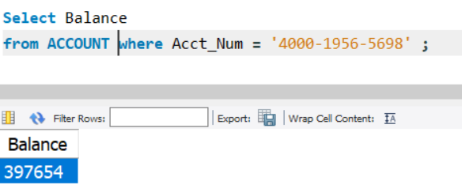
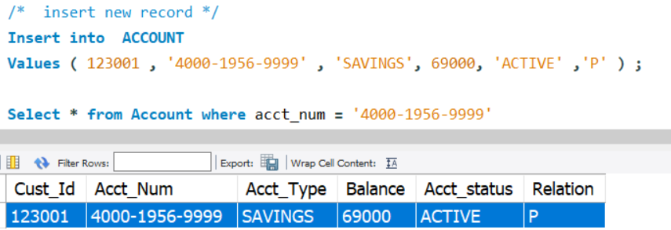
READ COMMITTED : Experience record level lock only with below practice.
Result of Instance - 2
/* MYSQL workbench Instance - 2 */
/* Check bank balance of different account */
Select Balance
from ACCOUNT
where Acct_Num = '4000-1956-5698' ;
/* insert a new record */
Insert into ACCOUNT
Values ( '4000-1956-9999’ , ‘SAVINGS’, 69000, ‘ACTIVE’ ,’P’) ;
In Instance - 2, the status of INSERT happens successfully.
However , the Instance -1 acquired lock at table level but restricted to existing records only.
Hence it allowed to insert new records from session -2 .
READ Committed

Slide 26
Transactions Modifiers:
READ and WRITE can also perform the isolation of transactions in the same Instance .
Transaction with READ and WRITE

Slide 27
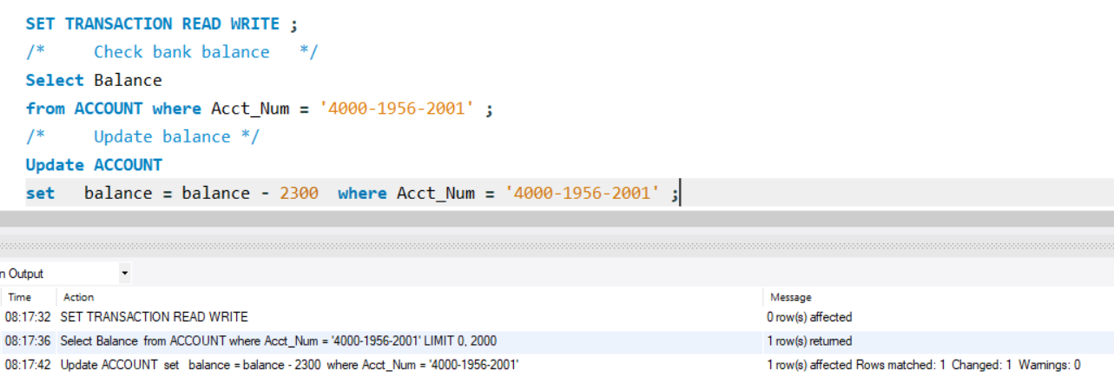
/* Instance - 1 */
SET TRANSACTION READ WRITE ;
/* Check bank balance */
Select Balance
from ACCOUNT
where Acct_Num = '4000-1956-2001' ;
/* Update balance */
Update ACCOUNT
set balance = balance - 2300
where Acct_Num = '4000-1956-2001' ;
Set Transaction with default - Read Write
READ WRITE : It is a default transaction,
So any statement is executed in current Instance.
Result of READ WRITE transaction
UPDATE statement is executed . Since Read Write is a default transaction modifier.

Slide 28
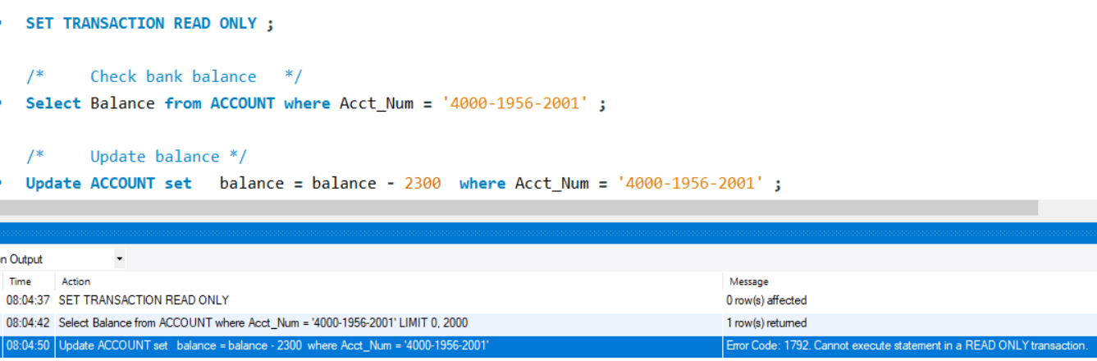
READ Only :
SET TRANSACTION READ ONLY ;
/* Check bank balance */
Select Balance
from ACCOUNT
where Acct_Num = '4000-1956-2001' ;
/* Update balance */
Update ACCOUNT
set balance = balance - 2300
where Acct_Num = '4000-1956-2001' ;
Set Transaction with READ Only
In the user Instance, transactions are isolated with READ / WRITE / both modifiers.
Result of READ only transaction
UPDATE statement throws an error :
Cannot execute statement in a READ ONLY transaction.

Slide 29
Modifiers when set at Instance level can be altered, but it doesn’t effect the current transaction.
However it will be effective only from next transaction.
SET SESSION TRANSACTION READ WRITE ;
/* In read and write mode */
START Transaction;
SET SESSION TRANSACTION READ ONLY ; /* Effective from next transaction */
Update ACCOUNT
set
balance = balance - 2300
where Acct_Num = '4000-1956-2001';
/* DML is executed */
COMMIT ; /* End the current transaction */
Altering the Modifiers : Read and Write

Slide 30
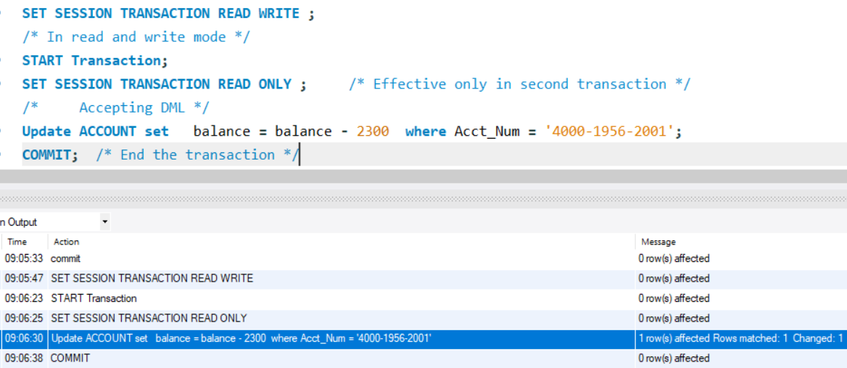
Altering the Modifiers : Read and Write
Result

Slide 31
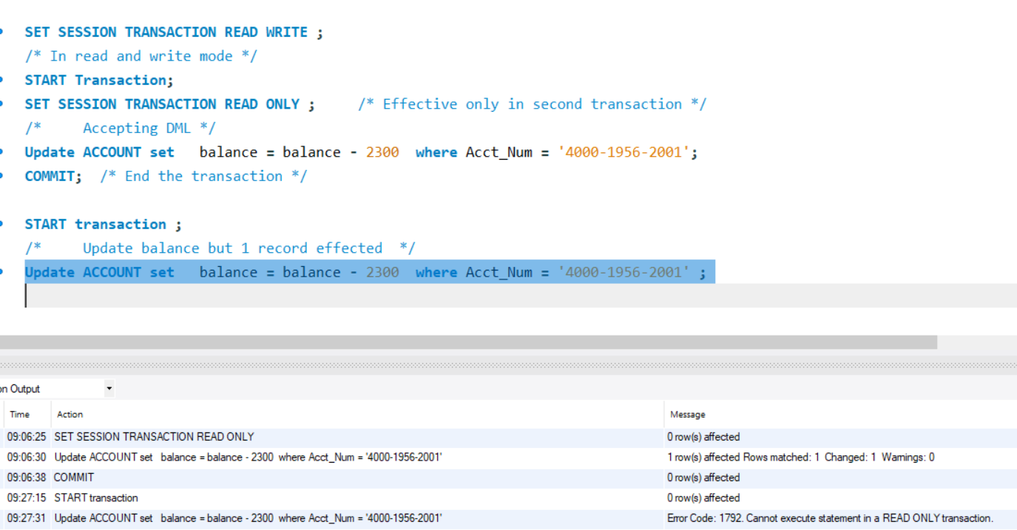
Alter Access modifiers : READ/ WRITE in user SESSION.
/* Second transaction: */
START transaction
/* Update will not execute */
Update ACCOUNT
set
balance = balance - 2300
where Acct_Num = '4000-1956-2001' ;
Set Transaction

Slide 32
SAVEPOINT and RELEASE SAVEPOINT statement

Slide 33
So far, ROLLBACK is issued on entire transaction. SQL engine facilitates to do partially rollback and do final commit.
SAVEPOINT statement is used to mark a portion of transaction with an identifier in a full length of transaction.
These checkpoints are later referred by ROLLBACK to undo partial transactions.
SAVEPOINT

Slide 34
Savepoints are so useful for recovery of errors in database applications.
Each Savepoint is labelled with a unique name to identify the location of intermediate portion of transaction.
E.g:
SAVEPOINT Label_1;
SAVEPOINT Label_2;
Using these Labels, user can undo the portion of the transaction.
E.g:
ROLLBACK TO Label_1;
SAVEPOINT

Slide 35
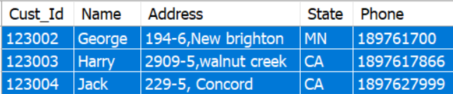
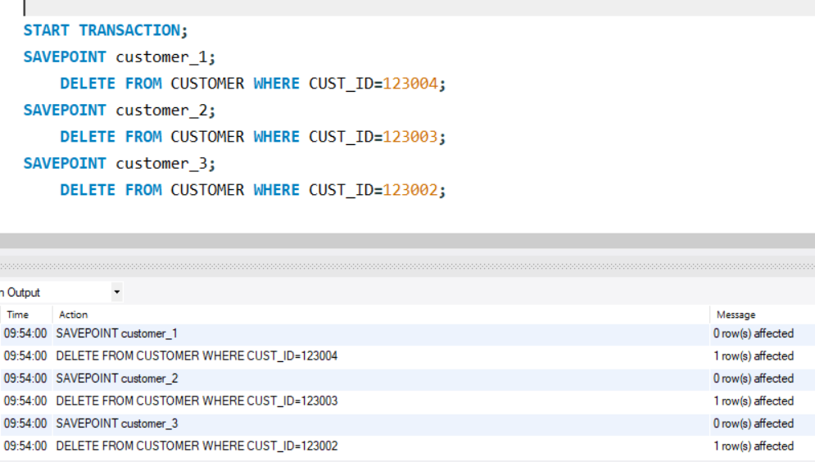
SELECT *
FROM CUSTOMER
WHERE CUST_ID in
(123002, 123003 , 123004 )
SAVEPOINT
Try: START TRANSACTION; SAVEPOINT customer_1; DELETE FROM CUSTOMER WHERE CUST_ID=123004; SAVEPOINT customer_2; DELETE FROM CUSTOMER WHERE CUST_ID=123003; SAVEPOINT customer_3; DELETE FROM CUSTOMER WHERE CUST_ID=123002;

Slide 36

/* Continue */
ROLLBACK TO customer_2; COMMIT;
SAVEPOINT
SELECT *
FROM CUSTOMER
WHERE CUST_ID in
(123002, 123003 , 123004 )
Note : Upon commit the transaction, savepoints defined in the transaction are lost.

Slide 37
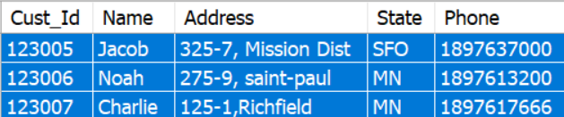
Savepoints that are created can be deleted in a transaction without affecting the transaction.
This is called releasing the individual savepoint from the total set of savepoints.
If SAVEPOINT has been released, you can no longer use the ROLLBACK command to undo transactions performed since the earlier SAVEPOINT.
Let us see an example of below:
SELECT * FROM CUSTOMER WHERE CUST_ID in ( 123007, 123006, 123005 )
RELEASE SAVEPOINT

Slide 38
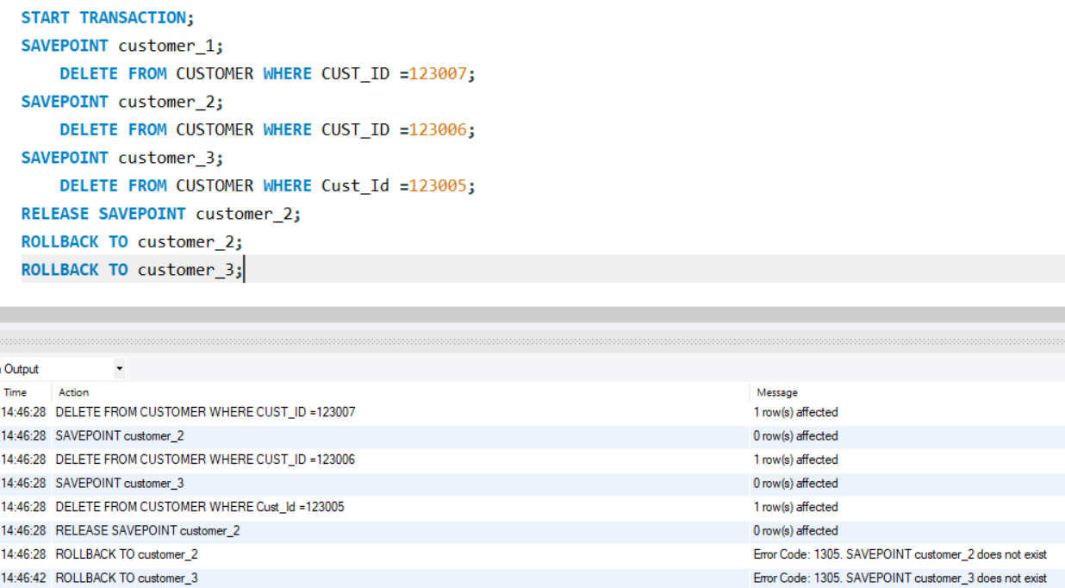
Example:
START TRANSACTION;
SAVEPOINT customer_1; DELETE
FROM CUSTOMER
WHERE CUST_ID =123007;
SAVEPOINT customer_2; DELETE
FROM CUSTOMER
WHERE CUST_ID =123006;
SAVEPOINT customer_3; DELETE
FROM CUSTOMER
WHERE Cust_Id=123005; RELEASE SAVEPOINT customer_2;
ROLLBACK to customer_2 ;
ROLLBACK to customer_3 ;
RELEASE SAVEPOINT
Result

Slide 39
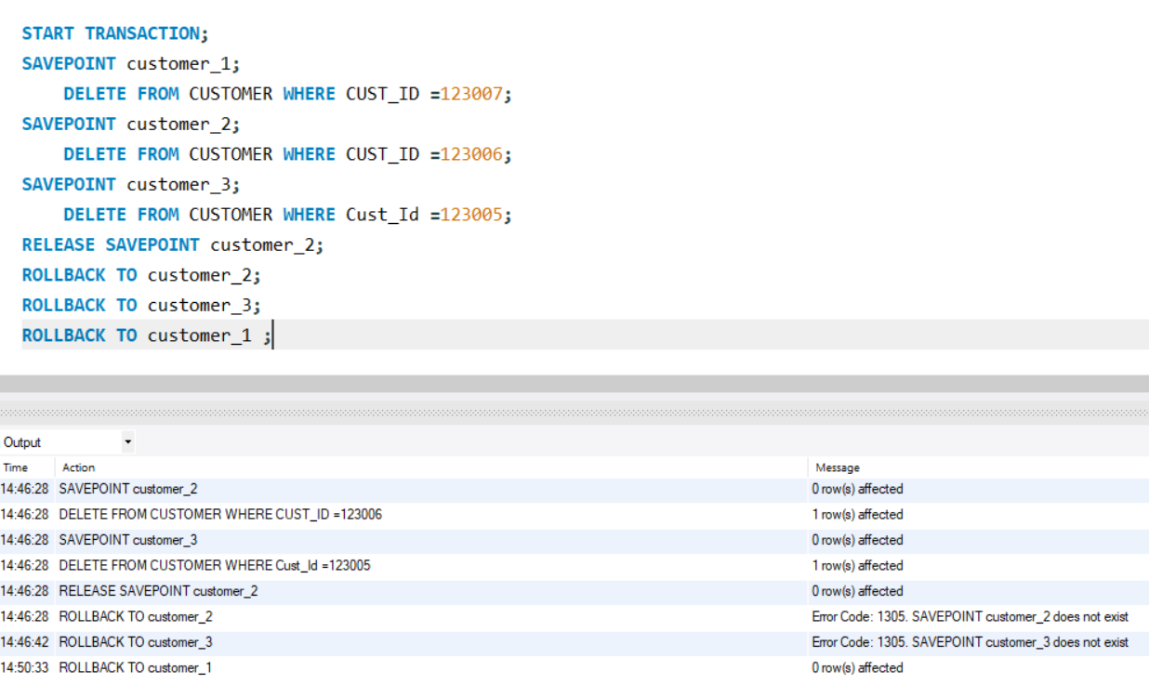
Rollback issued before RELEASE will be successful.
E.g: ROLLBACK TO Customer_1 ;
RELEASE SAVEPOINT

Slide 40
COMMIT Statement

Slide 41
COMMIT ends the current transaction.
It permanently saves the transaction effected changes to the physical data files and make others visible to the data changes.
After the COMMIT has been issued, the current transaction will exit and savepoint will disappear.
There is no option of database that will "undo" the transaction after committing the data.
COMMIT

Slide 42
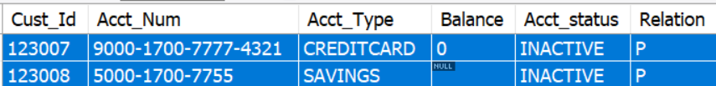
COMMIT
Example:
SELECT *
FROM ACCOUNT
WHERE Acct_status = 'INACTIVE'
AND (balance = 0 or balance is NULL ) ;
DELETE
FROM ACCOUNT
WHERE Acct_status = 'INACTIVE'
AND (balance = 0 or balance is NULL);
COMMIT;

Slide 43
In a current running transaction which is not yet physically committed to database, the transactional changes can be rollbacked and retain the original status of the data.
ROLLBACK plays a great roll during interactive operations when user tries to restrain from modifying the data.
ROLLBACK

Slide 44
Delete few rows and try to ROLLBACK to retain the original data.
DELETE FROM CUSTOMER WHERE CUST_ID =123006 select * from CUSTOMER;
CUST_ID NAME ADDRESS STATE_CODE TELEPHONE 123001 Oliver 225-5, Emeryville 452 1897614500 123002 George 194-6,New brighton 875 189761700 123003 Harry 2909-5,walnut creek 232 1897617866 123004 Jack 229-5, Concord 501 1897627999
ROLLBACK

Slide 45
Performing ROLLBACK
ROLLBACK; select * from CUSTOMER;
CUST_ID NAME ADDRESS STATE_CODE TELEPHONE 123006 Kiran 532 9542434422 123006 Kiran 532 9542434422 123001 Oliver 225-5, Emeryville 452 1897614500 123002 George 194-6,New brighton 875 189761700 123003 Harry 2909-5,walnut creek 232 1897617866 123004 Jack 229-5, Concord 501 1897627999
ROLLBACK

Slide 46
Locking

Slide 47
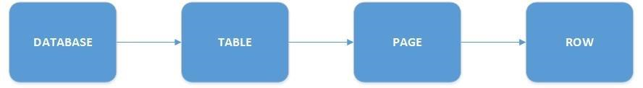
LOCKS are acquired by user transaction in a session.
SQL Engine locks objects when the transaction begins the DML statements on each record.
To ensure data integrity, DML statements acquire explicit locks on data records or tables.
Multiple users in an integrated environment can see changes applied by each other.
After the transactions are complete, LOCKs are however released.
Lock hierarchy:
The locks are acquired at any level for different purpose of transaction.
Lock

Slide 48
Locking Levels

Slide 49
Several types of locks are used for concurrency that each lock is specific to a transaction and does not affect other transaction.
Below are the system resources on which Locks are acquired.
RID: (Row ID) : Row-id is a unique address of individual record in a table.
DML statements when executed will try to isolate the records from other transactions using this rowid.Hence the row-ids are locked by DML statements, and then perform the operations.
Table: A transaction with DML statements lock the entire table and corresponding indexes.
This locks are more reliable in batch processing when performing huge volume of data, and restricts users to access the tables. So that the performance will not be degraded in terms of taking snapshots of data.
Key: Indexes are generated by default when primary Key is created on a table. Hence the locks are acquired on these keys .
Locking Levels

Slide 50
Memory level locks : Database memory is allocated with pages and pages forms an extent. Locks do occur at these stages.
Page: A page consists of 8-kilobyte (KB) used by a data file or index . Acquire the locks at page level and extent level.
Extent: Similarly an extents can be locked which consists of contiguous 8 data pages.
Database: Entire Database can be locked for maintenance purpose .
Locking Levels

Slide 51
Shared and Exclusive Locks

Slide 52
Every transaction executes DML statements needs to acquire Row-level locking.
Here are the two types.
Shared lock or Read Lock
Exclusive lock or Write Lock
Shared and Exclusive Locks

Slide 53
Shared lock is an initial lock acquired by a SELECT statement of a transaction to lock the rows for applying next DML statements.
Shared lock is useful to avoid deadlocks of multiple transactions if they are using same DML statements.
However, the other transactions can also acquire multiple shared locks (S) on the same records locked by first transaction.
Shared Locks

Slide 54
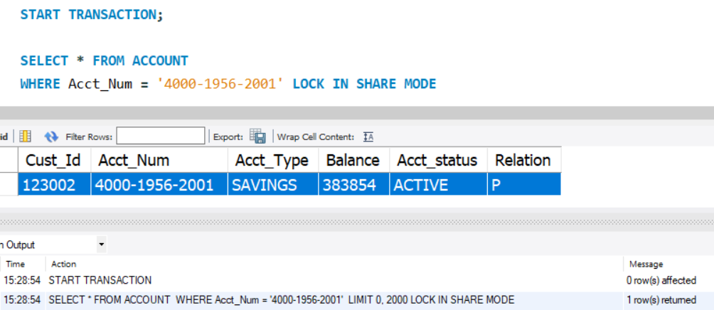
For example: Consider the following two sessions
SHARED lock is acquired by two sessions without any error.
Instance - 1
START TRANSACTION;
SELECT * FROM ACCOUNT
WHERE Acct_Num = '4000-1956-2001' LOCK IN SHARE MODE
Shared Locks between two SELECT Queries

Slide 55
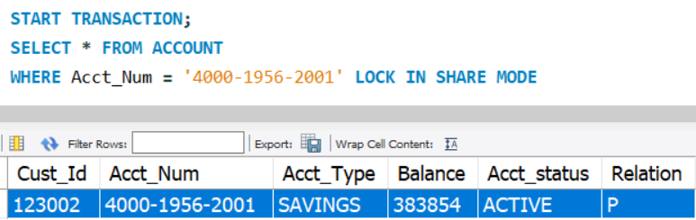
Shared lock is also acquired by Instance -2 .
Instance - 2
START TRANSACTION;
SELECT *
FROM ACCOUNT
WHERE Acct_Num = '4000-1956-2001'
LOCK IN SHARE MODE
Shared Locks between two SELECT queries

Slide 56
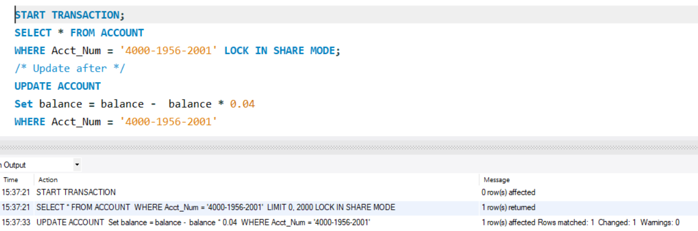
Session - 1
START TRANSACTION;
SELECT * FROM ACCOUNT
WHERE Acct_Num = '4000-1956-2001'
LOCK IN SHARE MODE;
UPDATE ACCOUNT
Set balance =
balance - balance * 0.04
WHERE Acct_Num = '4000-1956-2001'
Shared Locks with Update statement

Slide 57
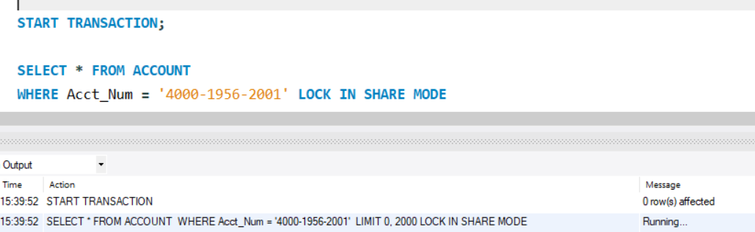
Session - 2
START TRANSACTION;
SELECT *
FROM ACCOUNT
WHERE
Acct_Num = '4000-1956-2001'
LOCK IN SHARE MODE
Shared Locks
Running / Awaiting :
Since the DML statement is executed in Instance -1 for same record, a shared lock is occured in Instance - 2 .
Instance - 2 is in Queue and gains the lock on the record after instance - 1 activity is done.

Slide 58
Exclusive locks are acquired by DML statements: DELETE, INSERT and UPDATE.
Data cannot be modified at a time by two DML statements. If they then its a deadlock or one transaction keeps waiting for other transaction.
Hence this lock is mandatorily acquired by any DML statement by default when executed to modify the records.
This lock cannot be shared with any other transactions as they have to keep waiting until the first DML transaction completes and commits its changes to database.
Note: Once the Exclusive lock ( X) is acquired , other transactions gain neither of the Shared ( S) nor Exclusive (X) Locks
Exclusive (X) Locks

Slide 59
Session - 1 /* acquired shared lock */
START TRANSACTION
SELECT * FROM ACCOUNT WHERE Acct_Num = '4000-1956-2001' LOCK IN SHARE MODE
Session - 2 /* acquired shared lock */
START TRANSACTION
SELECT * FROM ACCOUNT WHERE Acct_Num = '4000-1956-2001' LOCK IN SHARE MODE
Session - 1 /* acquired shared lock and exclusive lock */
START TRANSACTION
SELECT * FROM ACCOUNT WHERE Acct_Num = '4000-1956-2001' LOCK IN SHARE MODE UPDATE ACCOUNT Set balance = balance - balance * 0.04 WHERE Acct_Num = '4000-1956-2001'
Session - 2 /* acquired shared lock but did not gain exclusive lock ( waiting ) */
START TRANSACTION
SELECT * FROM ACCOUNT WHERE Acct_Num = '4000-1956-2001' LOCK IN SHARE MODE
UPDATE ACCOUNT Set balance = balance - balance * 0.04 WHERE Acct_Num = '4000-1956-2001'
Session - 3 /* Neither acquires Shared lock(S) nor Exclusive ( X) lock */
START TRANSACTION
SELECT * FROM ACCOUNT WHERE Acct_Num = '4000-1956-2001' LOCK IN SHARE MODE
UPDATE ACCOUNT Set balance = balance - balance * 0.04 WHERE Acct_Num = '4000-1956-2001'
Exclusive (X) Locks

Slide 60
Views

Slide 61
Virtual Tables
A virtual table is a derived form of data from a physical database tables.
Virtual tables are logically represented using physical data but do not store any data.
A virtual table is a construct of record set that are not actually tables.
so that these record sets are referenced in SQL statements like normal tables.
Virtual tables otherwise called as views and are stored as database objects in MYSQL Information_schema, and can be retrieved without re-writing it again.

Slide 62
What is a view?

Slide 63
What is view?
A view is a database object that is created using a Select Query with complex logic.
So views are said to be a logical representation of physical data
Views behave like a physical table and users can use them as database objects in any part of SQL queries
DML operations can be performed on base tables via views.
Since they are stored in the data dictionary , they can be retrieved easily

Slide 64
Types of views: Simple View
Simple views are created with a select query written using a single table
DML operations are easily performed just like performing on tables
Create VIEW Simple_view as
Select * from CUSTOMER ;

Slide 65
Complex View:
Complex view is created using a Select query written with multiple tables using JOINS, sub-queries, with clauses and conditionally filtered
Create VIEW Complex_view as
SELECT c.Cust_Id ,
a.ACCOUNT
From CUSTOMER c
JOIN ACCOUNT a
Where c.Cust_Id = a.Cust_Id
And a.balance > 300000

Slide 66
Inline View:
A subquery is also called as an inline view if and only if it is called in FROM clause of a SELECT query
It is not stored in any data dictionary like other views. It is dynamically defined in queries
SELECT * FROM
( SELECT c.Cust_Id , ba.ACCOUNT
From CUSTOMER bc
JOIN ACCOUNT ba
Where c.Cust_Id = ba.Cust_Id
And ba.balance > 300000)

Slide 67
Materialized View:
Unlike views, Materialized views stores the results of a complex SQL queries
These are so useful when the SQL engine takes time in execution of the SQL query logic and retrieve the results
Materialized views are also called as Snapshots of database tables

Slide 68
Materialized View:
These views are refreshed with new data with scheduled intervals
Materialized views are mostly used in data marts where there is a need for handling large volume of data that refers to history data
Data marts is a repositories of summarized data. This data is collected for analysis on a specific section or unit within an organization, for example, the sales department.

Slide 69
Materialized View:
create MATERIALIZED VIEW M_VW as SELECT c.Cust_Id , ba.ACCOUNT
From CUSTOMER c
JOIN ACCOUNT ba
Where bc.Cust_Id = ba.Cust_Id
And ba.balance > 99999

Slide 70
Refresh Methods
Fast & Complete
A fast refresh uses a log that compares the history and recent changes to its database tables and captures only the changes
Complete refresh truncates the whole materialized view data and refreshes with new changed data
Complete refresh is slow when compared with fast refresh method

Slide 71
How the RDBMS handles views

Slide 72
How RDBMS handles views
Views are stored in data dictionary. It means once they are created , they are used by several users at a time in different sessions
Select * from ALL_VIEWS where view_name in (‘SIMPLE_VIEW’ , ‘COMPLX_VIEW’)

Slide 73
How RDBMS handles views
The underlying data of base tables dynamically reflects in views since it logically represents the physical data
However, any updates to data is visible to views only when it is committed
E.g. Open two different SQL sessions and test Simple_View
Step1: In one session, issue the below:
Select * from Simple_view where Cust_Id = 123001

Slide 74
How RDBMS handles views
Step2: In another session, issue the below ( no auto commit/ commit )
Update CUSTOMER set telephone = 9701499878 where Cust_Id = 123001
Step3: Come back to first session , and again check the view to see the data doesn’t reflects the updated telephone
Select * from Simple_view where Cust_Id = 123001

Slide 75
How RDBMS handles views
Step4: Now go back to second session , and issue commit on Update DML statement
Commit;
Step5: Once again come back to first session, and check the updated telephone number.
Select * from Simple_view where Cust_Id = 123001

Slide 76
How RDBMS handles views
Views are invoked in FROM clauses of SELECT statements and avoids the complexity of debugging and writing large code
E.g:
Select CA_vw.Cust_Id,
bat.Acct_Num,
bat.Tran_Amount,
CA_vw.balance
from
Transaction bat
JOIN
Complex_view CA_vw
ON bat.Acct_Num = CA_vw.Acct_Num

Slide 77
How RDBMS handles views
In the previous example, the query looks so simple as Complex_view has taken care of additional logic of conditions and joining CUSTOMER table, and avoided too much of parent Query logic.

Slide 78
How RDBMS handles views
Views avoids direct access to physical data and protects from unauthorized users
Ex: If any user fires a SELECT query directly on physical table while the data is being loaded into base tables at the same time
Here RDBMS takes a before and after images of table data each time when updating is happening to data

Slide 79
How RDBMS handles views
The after image data is then stored to physical disk
During this time, if any user tries to do a SELECT on physical data , it will show the data from before image since the data is not commited
Before images are however deleted once the after image data is committed
Hence there is a lot of overhead to system to maintain before images for multiple users to ensure data integrity

Slide 80
Advantages and Disadvantages of
views

Slide 81
Advantages:
Views are stored queries and re-used
They are accessible by multiple users in different sessions
Scalability is high
They hide the confidential columns data like SSN, date of birth, Address , telephone

Slide 82
Advantages:
Avoids direct access to physical data
Views protects the data when views are invoked by downstream users to build web applications that are prone to hackers
Materialized views are useful in a centralized environment where multiple users access it in batches of data rather streaming data

Slide 83
Disadvantages:
When a base table of an associated view is dropped, it becomes obsolete
Queries using views are bit slow compared to accessing data directly from physical tables
Because , SQL engine will take an additional processing of semantics checking of view each time when queries are running on it

Slide 84
Disadvantages:
Views created using aggregate functions are restricted to use in WHERE clauses
Materialized views stores physical data hence it holds redundant data and results in consumption of additional space for its Mviews and Logs
Views are in-efficient when joined with remote database tables as they consume lot of I/O transactions between local and remote database tables

Slide 85
Horizontal View

Slide 86
Horizontal View
A Horizontal view dynamically represents the data without aware of the columns
The view does not necessary to know about the number of columns and its data types of the respective base tables
However the base tables are explicitly defined in the view

Slide 87
Example
Create view Horizontal_view as
Select ba.*
From ACCOUNT where balance > 99999

Slide 88
Example
In this previous example, the wildcard - “*” references all of the columns belongs to base tables mentioned in the view
Any changes to the column names , data types doesn’t affect the view creation

Slide 89
Vertical View

Slide 90
Vertical View
A vertical view built with predefined columns , however the changes to column data types does not affect the view unless they are type-casted or applied with any system functions.
CREATE VIEW Vertical_view AS SELECT Cust_Id,
Acct_Num,
Balance,
Acct_Type,
Acct_status,
Relation
FROM ACCOUNT

Slide 91
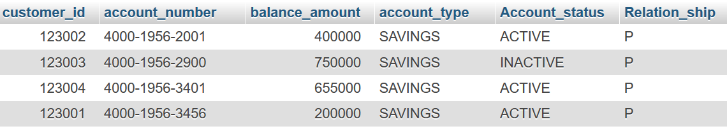
Vertical View
In this example, the columns that are explicitly mentioned while creating the view and those are same as base tables
Otherwise it throws an error if any changes applied to columns

Slide 92
Horizontal view Vs Vertical view
Horizontal views | Vertical views
Columns are represented with “*” card | Columns are explicitly defined
Query execution is dynamic and re-calculate the execution plan each time because columns are unknown. | Underlying query execution plan is not repeated because view columns are in sync with base tables.
Maintenance is easy as the view is not worried about changes to columns | View maintenance is required and need to be adjusted according to base table changes.

Slide 93
Vertical View
Horizontal views | Vertical views
Users have access to all view columns like accessing all base table columns. | Many of the columns are hidden.
Users can apply any data type conversions while using the views. | Any data type conversions can be applied unless the other functions inside view definition are not compatible.
Views can be updated easily. | These views can also be updated unless any functions are used on columns in view.

Slide 94
Row Column subset view

Slide 95
Row column subset View
A View can be created to represent the subset of records and lesser columns in order to filter the records and hide the columns
CREATE VIEW Subset_view AS SELECT
Cust_Id,
Acct_Num,
Balance
FROM ACCOUNT
Where Balance > 700000 ;

Slide 96
Row column subset View
In this example, only few columns are displayed that are defined in the subset view. The other columns are hidden
Also, the records are filtered for which the balance is less than or equal to 700000

Slide 97
Grouped Views

Slide 98
Group View
Grouping views are created using a SELECT query with grouping functions applied on multiple rows of data
The grouping functions are dynamically applied on rows of data and displays aggregate results only

Slide 99
Group View
Create view Grouping_view
(Acct_Num, total_transaction)
as
select Acct_Num ,
sum(Tran_Amount )
from Transaction
group by Acct_Num ;

Slide 100
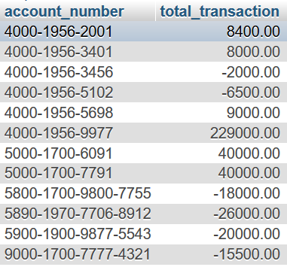
Group View
In this example, only the aggregate transaction amount is displayed

Slide 101
Joined Views

Slide 102
Joined View
These views represent the data from more than one base tables joined using key columns
The underlying query can have JOINS or subqueries on base tables

Slide 103
Joined View
Create View Joined_view
As
Select c.Cust_Id,
c.Name,
a.Acct_Num,
a.Acct_Type,
a.Balance,
c.telephone
FROM ACCOUNT a
JOIN CUSTOMER c
ON a.Cust_Id = c.Cust_Id ;

Slide 104
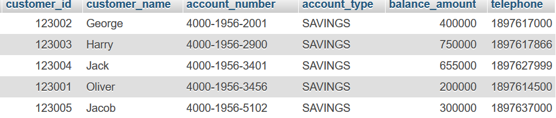
Joined View

Slide 105
Joined View
In this example, the underlying query is joined with two tables and selected their respective columns
From the view point, the representation of columns are viewed as single entity without any complexity

Slide 106
CHECK OPTION

Slide 107
WITH CHECK OPTION
Simple views can be queried and allow DML operations
In order to restrict users to perform DML operations on sensitive columns, WITH CHECK OPTION” is optionally used as a constraint

Slide 108
Example
Create view View_with_Check
As Select * From ACCOUNT
Where Balance > 5000
WITH CHECK OPTION ;
Insert into View_with_Check values
( 123001, '4000-7843-3002', 'SAVINGS',4000,'ACTIVE', 'P')

Slide 109

Example
In this example, you can insert any balance amount without the CHECK OPTION constraint irrespective of the condition in the view

Slide 110
WITH CHECK OPTION ( LOCAL)
LOCAL CHECK option pertains to only local conditions of the view and ignores the conditions of dependent views
Create view normal_view as
Select * from ACCOUNT
where Balance >= 80000;
create view local_view as
select * from normal_view
where Balance <= 90000
with local check option;

Slide 111
WITH CHECK OPTION ( LOCAL)
Insert into cascaded_view values
( 123001, '6500-3823-4032', 'SAVINGS',65000,
'ACTIVE','P')

Slide 112
WITH CHECK OPTION ( LOCAL)
In this first example, you can bypass the condition and insert balance amount of 85000 in normal_view
Local_view is created on normal_view will be local will validate its own conditions
Hence the records with any balance less than 90k are accepted, and ignores the dependent view condition

Slide 113
WITH CHECK OPTION ( CASCADED)
A normal view conditions are bypassed when performing DML statements
CASCADED CHECK option ensures to satisfy all of the conditions of dependent views

Slide 114
WITH CHECK OPTION ( CASCADED)
Create view normal_view as
Select * from ACCOUNT
where Balance >= 80000;
create view cascaded_view as
select * from normal_view
where Balance =< 90000
with cascaded check option;
Insert into cascaded_view values
(123001, '5000-1253-4312', 'SAVINGS' , 70000, 'ACTIVE','P'

Slide 115
WITH CHECK OPTION ( CASCADED)
In this first example, you can bypass the condition and insert balance amount of 85000 in normal_view
Such cases, cascaded_view is created on normal_view to ensure that the conditions of both views are satisfied
Hence the records with balance between 80k and 90k are only accepted

Slide 116
Drop view

Slide 117
Drop View
Without affecting the base table data, any type of view can be dropped
E.g:
Drop view view_name;

Slide 118
Materialized view

Slide 119
Materialized views ( Oracle )
M-views are logical created using physical tables but it stores the data when they are executed
Materialized views are executed frequently to refreshed with new data of base tables
M-views uses mainly two refresh methods : Fast and Complete

Slide 120
Materialized views ( Oracle )
Create materialized view mview_account
As Select * From ACCOUNT
Where Balance > 500000 ;
In this example, materialized view is created with a SQL query logic but does not hold any physical data
In order to feed the data to materialized views, materialized views must be refreshed

Slide 121
Materialized views ( Oracle )
Materialized views are refreshed with physical data. Let us look at how they are refreshed
E.g:
execute dbms_mview.refresh( ‘mview_account’) ;
Select * from mview_account ;

Slide 122
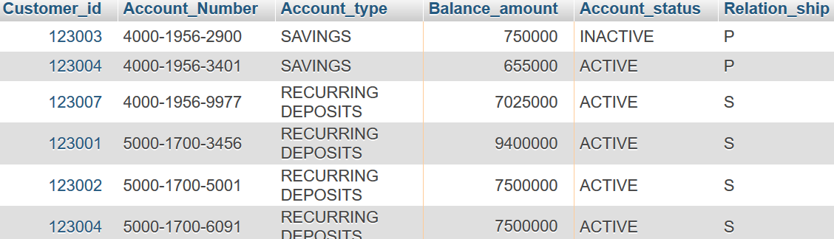
Materialized views ( Oracle )
Mview_account is refreshed with data only after it is explicitly refreshed with system package

Slide 123
Complete Refresh:
Materialized view uses complete refresh method to truncate and refresh with new data from Query it is defined with
Create materialized view
REFRESH COMPLETE
mview_account_RC
As Select * From ACCOUNT
Where Balance > 500000
execute dbms_mview.refresh( list => ‘mview_account_RC’ , method => 'C’);

Slide 124
Complete Refresh:
In this example, materialized view always uses complete method to reload the data every time it is refreshed explicitly
Here the refresh time is equals to the time of query execution and loading of the data

Slide 125
FAST Refresh:
Materialized view uses FAST refresh method with only changed data of the base query
Create materialized view fastrefresh_log on ACCOUNT with sequence ;
Create materialized view
REFRESH FAST
mview_account_RFast
As Select * From ACCOUNT
Where Balance > 500000 ;

Slide 126
FAST Refresh:
execute dbms_mview.refresh( list => ‘ mview_account_RFast’ , method => 'F’);
In this example, materialized view always uses FAST method to capture only updated or inserted data every time it is refreshed explicitly
The changed data is always maintained in a log created on the base table which being used by fast refresh later

Slide 127
Thank You

